Slide 1
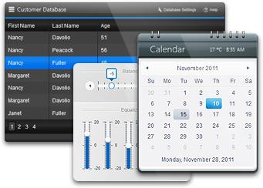


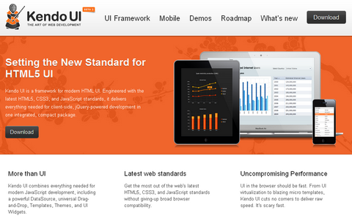

Kendo UI Part 1
Telerik Framework

Slide 2

Table of Contents
Installation & Introduction
Basic Widgets
DataSource
Advanced Widgets
Templates
Validator

Slide 3

Installation & Introduction
Getting ready for Kendo UI

Slide 4

Installation
First include the style sheets
kendo.common.min.css (common css first)
kendo.{theme}.min.css (theme css)
Then include the JavaScript files
jquery.min.js (jQuery is needed first)
kendo.web.min.js (Kendo UI web)
More information here
http://docs.telerik.com/kendo-ui/getting-started/introduction

Slide 5
Installing Kendo UI
Live Demo

Slide 6
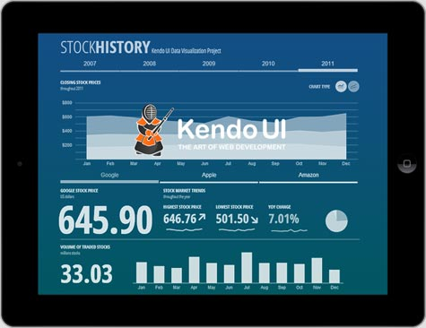
Basic Widgets
The cool stuff!

Slide 7
Basic Widgets
Instantiating Widgets
Appended to jQuery objects (DOM elements)
May have additional options depending on the widget and the usage of it
$('#menu').kendoMenu();
$('#grid').kendoGrid({
dataSource: carsDataSource,
editable: true,
toolbar: ['create']
});

Slide 8
Basic Widgets
Getting Widgets Reference
Use jQuery data function
Pass the Pascal case name of the widget prefixed with "kendo"
$('#menu').data('kendoMenu');
$('#grid').data('kendoGrid');

Slide 9
Basic Widgets
Using Widgets API
Widgets expose functions and properties
$('#ac').kendoAutoComplete(['1', '2', '3']);
var autocomplete = $('#ac').data('kendoAutoComplete');
autocomplete.value('4');
var value = autocomplete.value();
alert(value); // Displays '4'

Slide 10
Basic Widgets
Subscribing to events
Specify at initialization
Use bind and unbind
$('#ac').kendoAutoComplete({
change: function() { this… }
});
$('#ac').kendoAutoComplete();
var autocomplete = $('#ac').data('kendoAutoComplete');
autocomplete.bind('change', function() { this… });

Slide 11
Basic Widgets
The DOM elements
The element property
The wrapper property
var element = $('#myWindow').data('kendoWindow').element;
var element = $('#myWindow').data('kendoWindow').wrapper;

Slide 12
Basic Widgets
Destroying widgets
Using the destroy function
Deleted the widget instance
Removes auto generated HTML content
Destroys all child widgets
$('#myGrid').data('kendoGrid').destroy();

Slide 13
Common Functions
Live Demo

Slide 14
Color Picker
Kendo Color Picker
palette: "basic", "websafe", array of colors
columns: number
value: string
methods: close, open, color, enable
events: change, select, open, close
$('#element').kendoColorPicker({
palette: 'basic'
});

Slide 15
Date Time Picker
Kendo Date Time Picker
options: value, min, max, format, start, interval
methods: close, open, enable, min, max
events: change, open, close
$('#dateTimePicker').kendoDateTimePicker({
value: new Date(2000, 10, 10, 10, 0, 0),
min: new Date(1950, 0, 1, 8, 0, 0),
max: new Date(2049, 11, 31, 18, 0, 0)
});

Slide 16
Masked Text Box
Kendo Masked Text Box
mask: 0, 9, #, L, ?, &, C, A, a
promptChar: string
methods: enable, readonly, value
events: change
$('#maskedtextbox').kendoMaskedTextBox({
mask: '(000) 000-0000',
promptChar: '*'
});

Slide 17
Menu
Kendo Menu
<ul id="menu">
<li>Normal Item
<ul>
<li>First</li>
<li>Second</li>
</ul>
</li>
<li>Third</li>
</ul>
$("#menu").kendoMenu();

Slide 18
TabStrip
Kendo TabStrip
<ul>
<li class="k-state-active">Paris</li>
<li>New York</li>
</ul>
<div>
<p>Rainy weather in Paris.</p>
</div>
<div>
<p>Sunny weather in New York.</p>
</div>
$("#tabstrip").kendoTabStrip();

Slide 19
Tooltip
Kendo Tooltip
options: position, width, height, content, showOn, autoHide
methods: show, hide, refresh
events: show, hide
$("#target").kendoTooltip({ content: "Tooltip content" });

Slide 20

DataSource
Data, data, data

Slide 21

DataSource
Abstraction over local or remote data
Play central role in Kendo UI applications
Retrieve data from local or remote end point
Provides CRUD operations and serialization
Provides filtering, grouping, page sizing
Synchronizing updates (batch and normal)
And many more

Slide 22

DataSource
Initialization with new kendo.data.DataSource
Takes an JSON object as parameter
The JSON object contains variable options
data option – array of same objects or string
var cars = [
{ make: 'Opel', model: 'Insignia' , year: '2009'},
{ make: 'Audi', model: 'A5', year: '2008'},
{ make: 'BMW', model: 'M3', year: '2010'},
{ make: 'Mercedes', model: 'CL', year: '2011'}
];
var carsDataSource = new kendo.data.DataSource({
data: cars
});

Slide 23

DataSource
columns option – array of objects
field, width, title
aggregate option – array of objects
field, aggregate
"average", "count", "max", "min", "sum"
…
columns: [
{ field: 'make', width: 50, title: 'Make' },
{ field: 'model', width: 50, title: 'Model' }
],
aggregate: [
{ field: 'power', aggregate: 'sum' },]
…

Slide 24

DataSource
filter option – array of objects
logic option: ‘and’, ‘or’
filters option: array of objects
field, operator, value
operators: "eq", "neq", "lt", "lte", "gt", "gte"
…
filter: {
logic: 'and',
filters: [
{ field: 'make', operator: 'eq', value: 'Audi' },
{ field: 'year', operator: 'gt', value: 2006 }
]
}
…

Slide 25

DataSource
group option – array of objects
field, dir, aggregates
dir: ‘asc’ and ‘desc’
…
group: {
field: 'make',
dir: 'desc',
aggregates: [
{ field: 'power', aggregate: 'max' },
{ field: 'make', aggregate: 'count' }
]
}
…

Slide 26

DataSource
sort option – array of objects
field, dir
dir: ‘asc’ and ‘desc’
…
sort: {[
{ field: 'year', dir: 'desc' },
{ field: 'make', dir: 'asc' }
]}
…

Slide 27

DataSource
transport option – array of objects
create, read, update, destroy
url, dataType
parameterMap – function for parsing data
…
transport: {
read: {
url: 'http://someurl.com/api/read',
dataType: 'json'
},
…

Slide 28

DataSource
batch option – boolean
page option – number
pageSize option – number
serverPaging option – boolean
serverSorting option - boolean
events – change, error, sync
…
change: function (e) {
…
}
…

Slide 29
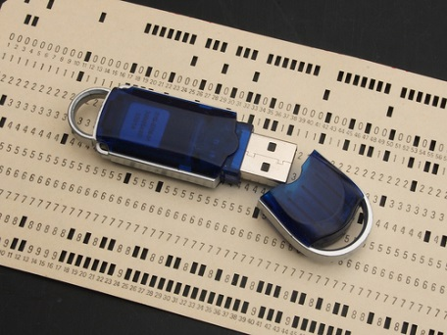
DataSource
Methods
add – object or Kendo.data.model
aggregate – get or set configuration
aggregates – returns result
at – indexator
data – gets or sets the data array
fetch – reads the data, needs ready function
filter – gets or sets the configuration
group – gets or sets the configuration
indexOf – return the index of an object in data

Slide 30
DataSource
Methods
insert – inserts data at specified index
page – gets or sets the current page
pageSize – gets or sets the page size
read – reads the data
remove – removes item
sort – gets or sets the configuration
sync – syncs data with remote service
total – number of items in data
view – return corresponding data (with fetch)

Slide 31
DataSource
Live Demo

Slide 32

Templates
Mustache, Beard, Eyebrows

Slide 33
Templates
Kendo UI templates – in script tags
Type of tag – “text/x-kendo-template”
Should have id attribute
Initialized with kendo.template($('#id').html())
Takes object parameter with data
Appended to other DOM (jQuery) elements
<script type="text/x-kendo-template" id="some-id">
// template </script>
var tmpl = kendo.template($('#some-id').html());
$('#some-tag').append(template({ /* data obj */ }));

Slide 34

Templates
Syntax
Normal HTML syntax
# Between number sign you can write JS code
#: Encodes the values
#= Takes the value from a parameter
<script type="text/x-kendo-template" id="car">
<div>
<span>#: make #, </span>
<a href="/cars/#= id #">#: model #</a>
</div>
</script>
var carTemplate = kendo.template($('#car').html());
$('#some-tag').append(template({
id: i, make: car.make, model: car.model }));

Slide 35
Templates
Live Demo

Slide 36

Validator
Client-side data validation

Slide 37
KendoUI Validator
Validator
Data is validated through attributes on tags
required – makes field required
pattern – defines RegEx for validation
min – defines minimum value
max – defines maximum value
validationMessage – message if not valid
<input type="tel" id="tel" name="tel" placeholder="Phone"
pattern="\d{10}"
required
validationmessage="Phone should have 10 digits"
/>

Slide 38
KendoUI Validator
Validator
Initialized on jQuery object with .kendoValidator().data('kendoValidator');
Validity is checked with .validate()
var validator =
$('#id').kendoValidator().data('kendoValidator');
if (validator.validate()) {
// do something
}
else {
// do something else ☺
}

Slide 39
Validator
Live Demo

Slide 40
Advanced Widgets
The cooler stuff!

Slide 41
Editor
Kendo Editor
tools: variety of tools
methods: refresh, update, value
events: change, keyup, keydown, select
$("#editor").kendoEditor({
tools: [
"bold",
"italic",
"underline",
"foreColor"
]
});

Slide 42
TreeView
Kendo TreeView
<ul id="treeView">
<li>Item 1
<ul>
<li>Item 1.1</li>
<li>Item 1.2</li>
</ul>
</li>
<li>Item 2</li>
</ul>
$("#treeView").kendoTreeView();

Slide 43
TreeView
Kendo TreeView
methods: append, expand, findByText, parent
events: expand, change, select
dataSource: [
{
text: "Item 1",
items: [
{ text: "Item 1.1" }
]
},
{ text: "Item 2" }
]

Slide 44
Window
Kendo Window
options: position, actions, resizable, visible, draggable, modal, title
methods: open, close, center, maximize, minimize
events: close, open, resize
$("#window").kendoWindow();

Slide 45
ListView
Kendo ListView
options: template, dataSource, selectable, editable, editTemplate
methods: add, remove, edit, save, select
events: change, edit, save
$("#repo-list").kendoListView({
dataSource: dataSource,
template: kendo.template($("#tpl").html())
});

Slide 46
Grid
Kendo Grid
options: dataSource, editable, toolbar, columns, pageable, scrollable, sortable, filterable, groupable
methods: addRow, editRow, editCell, refresh, saveChanges, select, cancelChanges
events: cancel, change, edit, save

Slide 47
Grid
Kendo Grid
$('#grid').kendoGrid({
dataSource: dataSource,
editable: true,
toolbar: ['create'],
pageable: {
input: true,
numeric: false
},
scrollable: false,
sortable: true,
filterable: false,
groupable: true,
columns: []
});

Slide 48

Additional Info
More is better!

Slide 49
Additional Info
Documentation
http://docs.telerik.com/kendo-ui/
Demos
http://demos.telerik.com/kendo-ui/
Training room
http://trykendoui.telerik.com/
Downloads
http://www.telerik.com/download/kendo-ui

Slide 50
Mobile, Charts and MVC
A whole other universe!

Slide 51
Kendo UI Web
http://academy.telerik.com

